Slide 1







BAIN AND COMPANY: ATTRITION
Presented By
Jennifer Opal &
Ibukunoluwa Adeyemi
(Team 14)

Slide 2



EXECUTIVE SUMMARY
There were many avenues explored in order to find some useful insights from the data. You’ll find many included in the report attached if you’d like to learn more.
There may be several reasons why the churn rate is so high but here is a summary of our analyses:
Married and single employees made up the largest groups pf employees leaving.
The group largely made up of those with qualifications in Life Sciences and Medical fields. Could there be a commonality between their work expectations because of their experience that is impacting their experience at the company?
`Research and Development` as well as the Sales department has been impacted significantly. Are there similar management styles across these department that needs to be restructured or changed?
Women also make up the largest group to be leaving.

Slide 3


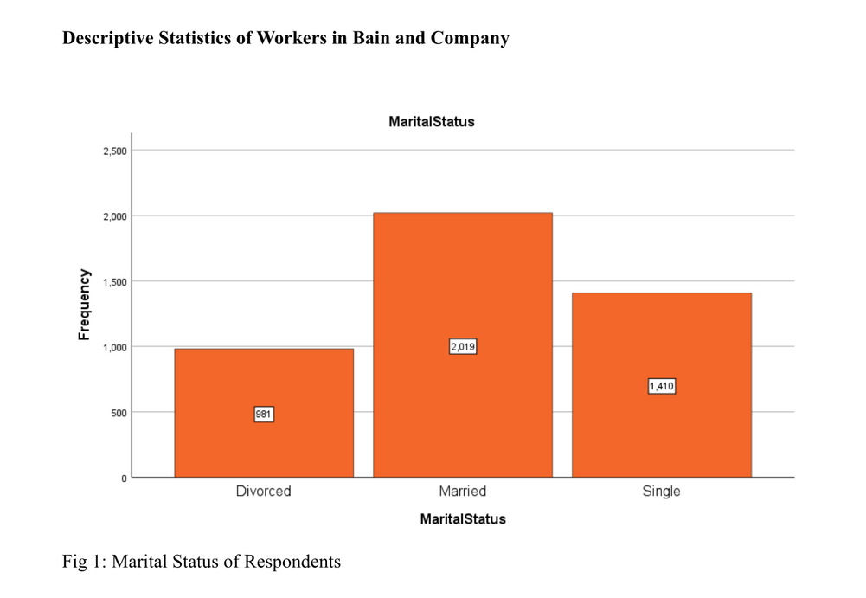
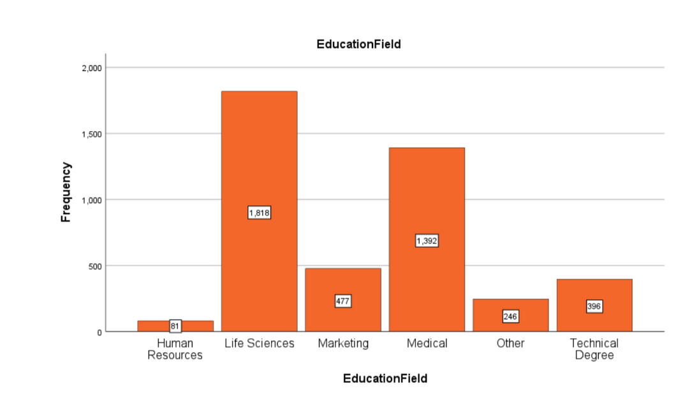


THE BREAKDOWN...

Slide 4

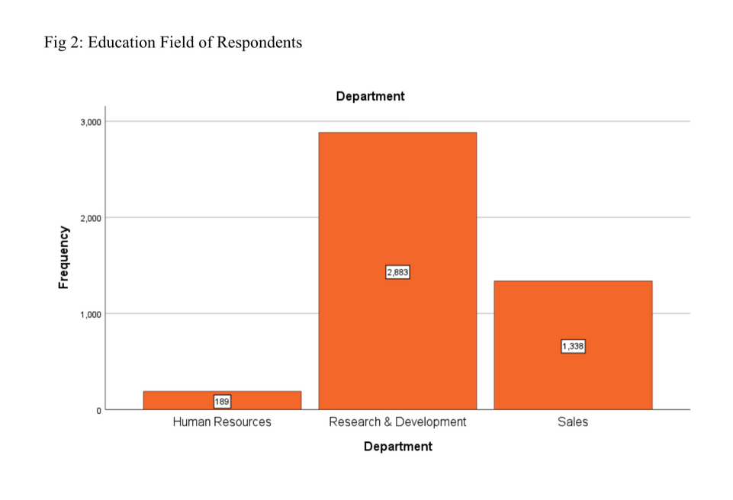
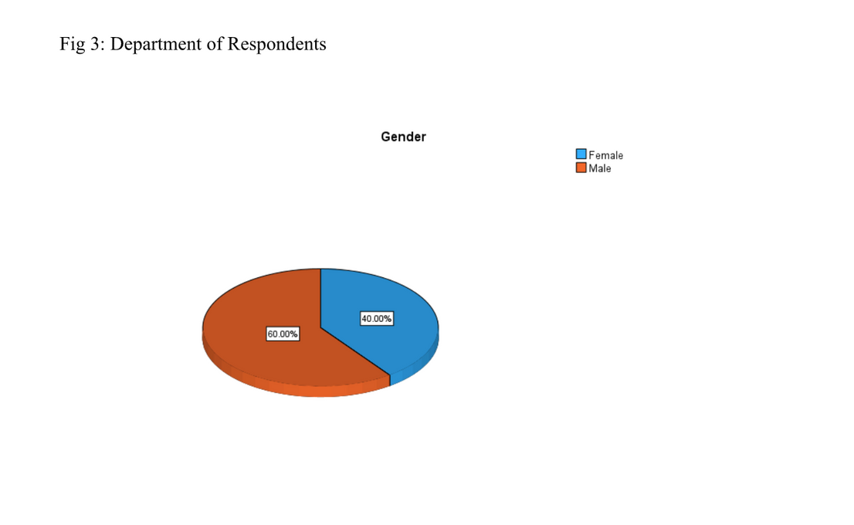




Slide 5


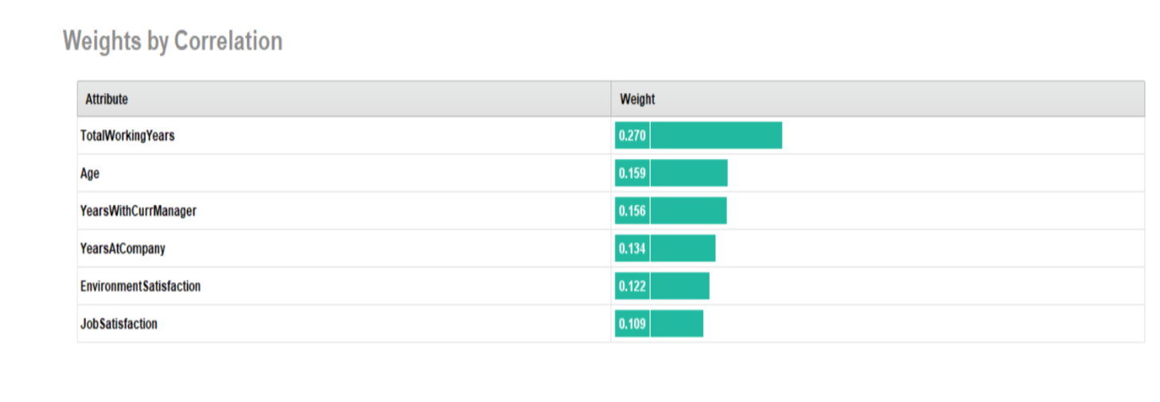

OUR GUESS...
In our prediction model, we used the following attributes based of of their weight
by correlation. We believe it will have a great
impact in predicting our attrition rate. The correlation measures both the strength and direction of the linear relationship between two variables.

Slide 6





QUICK RECAP...
LOGISTICAL REGRESSION
DECISION TREE
Imagine a tree where every branch is a question and each question helps to lead you to a final answer, the trunk/root of the tree.
Imagine a red piece of string going through a group of people to help provide some answers for what’s coming next.

Slide 7
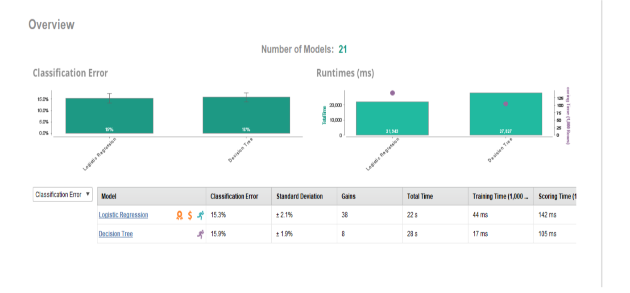
THE EVIDENCE...
The classification error is just a way of counting how many mistakes you made when sorting the balls. If you made five mistakes out of a total of 100 balls, then your classification error rate would be 5%.

Slide 8


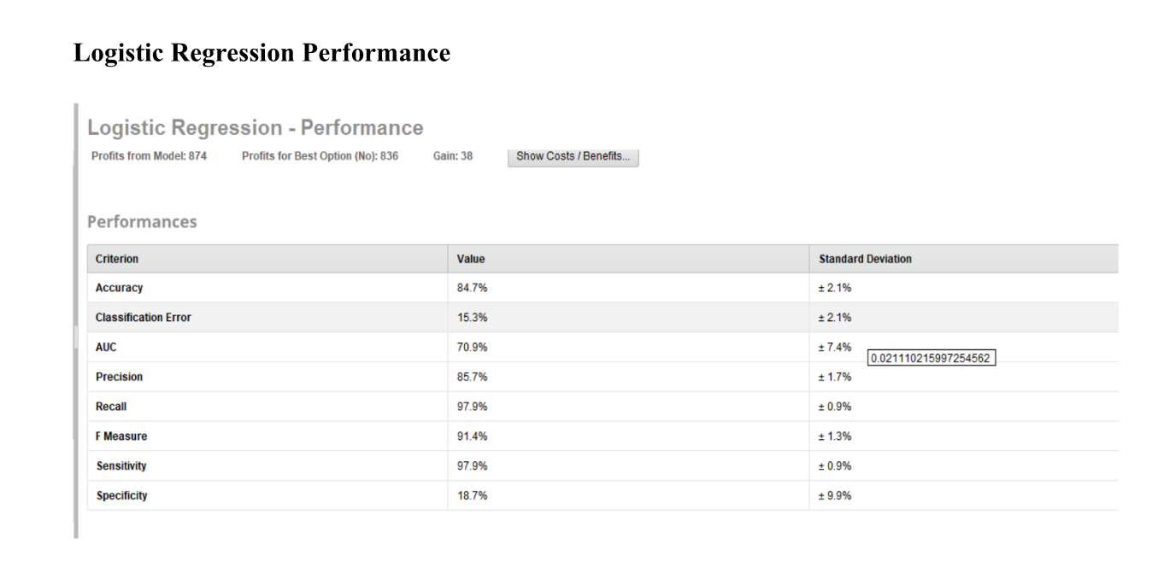

WHAT WE THINK...
RESULT

Slide 9
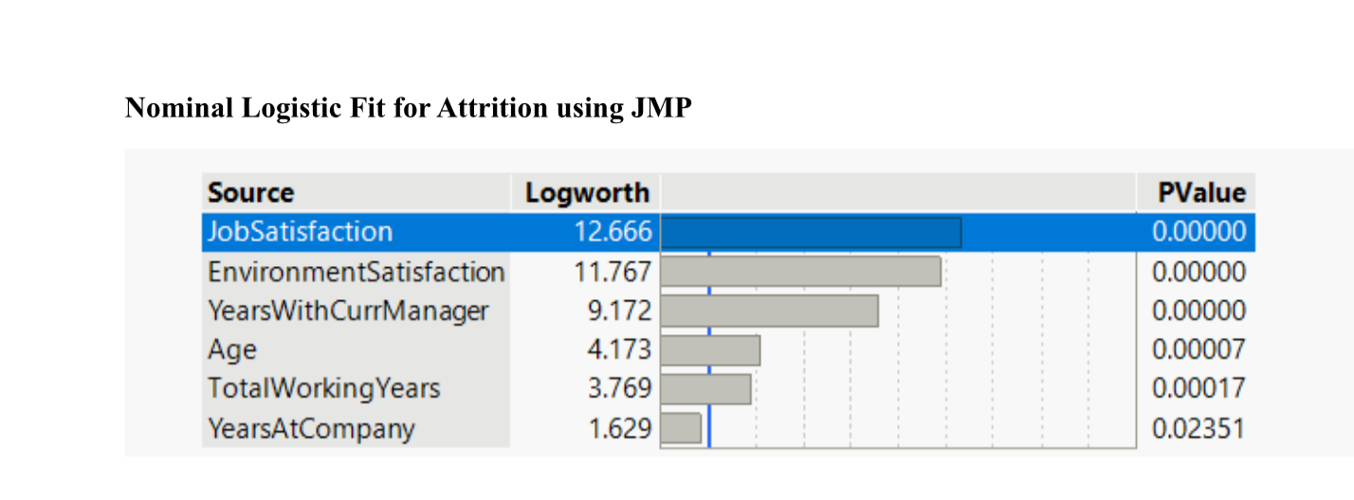
TAKE IT FURTHER...
Logworth tells you how important it is.

Slide 10
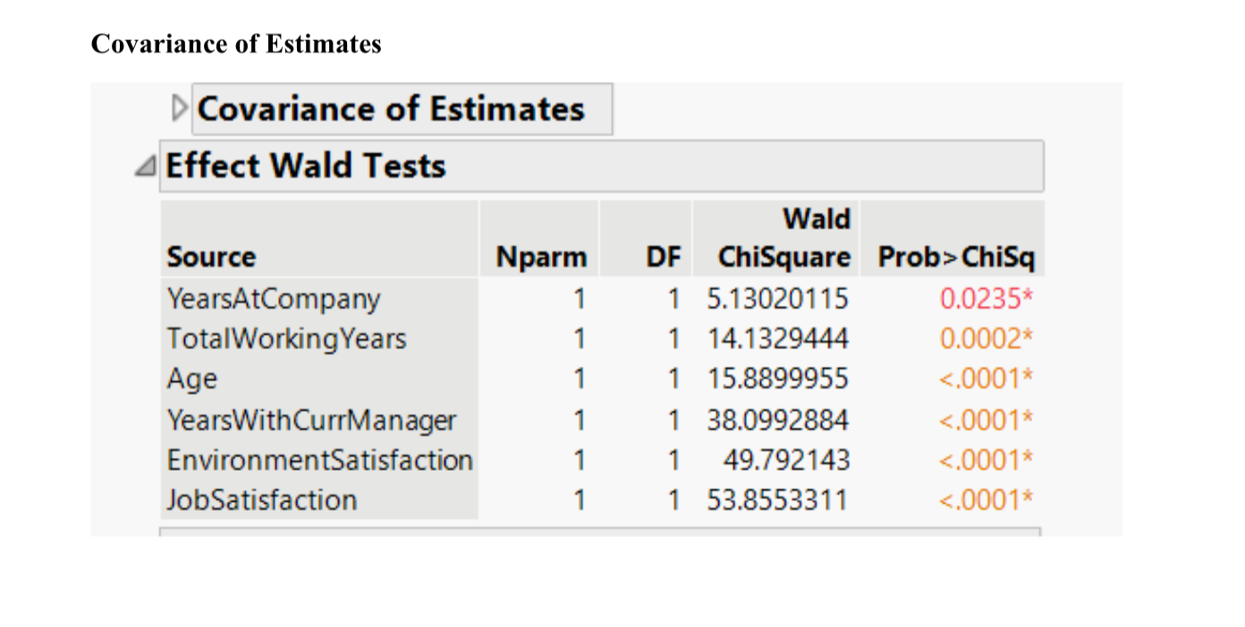
EVEN FURTHER...
Focus on the ChiSquare column here, the higher the nunber, the more of an impact it has

Slide 11
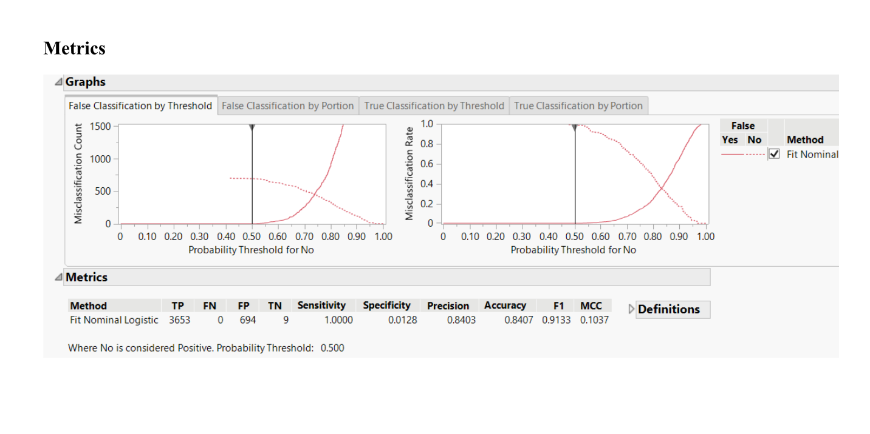
EVEN FURTHER...

Slide 12
SUGGESTIONS
Having annual check-ins with the employees once they reach a year. Ensure that they have clear frameworks with what to aim for. This could help contribute to employees having future goals for progression within the company hence increasing brand loyalty.
For promotions, it may help to have managers across teams give unbiased feedback on those in line for promotion based on what the employee believes warrants a promotion in line with their framework.
Implementing a one-day paid Mental Health Day every month. This can show that the company cares for the wellbeing of their employees.
Consider offering flexibility to your employees so they can work away from the office.
APPENDIX
Do refer to the attached report for further analyses.

Slide 13
THANK YOU!
Do get in touch for further questions.

